Slide 1
LNG1-27 September

Slide 2
Prewriting
Getting Ideas

Slide 3
Prewriting Strategies
Annotate text (read with a pen and/or pencil)
Highlighting
Underlining
Margin notes

Slide 5
Prewriting Strategies
List
Decide what category you will list
Relevance? Truthfulness? Characters? Evidence?
Brainstorm
Write whatever comes to your mind
Don’t worry about grammar or being correct

Slide 6
Possible List Categories
Is the character afraid?
What evidence do you see?
What is the character thinking?
What does the character see?
The Scream by Edvard Munch

Slide 7
Prewriting Strategies
Keep a Journal
Make it a place to store thoughts
Ask Questions
What?
Who?
When?
Where?
How?

Slide 8
Prewriting Strategies
Focused Freewriting
Pour out ideas in a steady stream of writing
Do not worry about grammar, structure, vocabulary
Just write

Slide 9
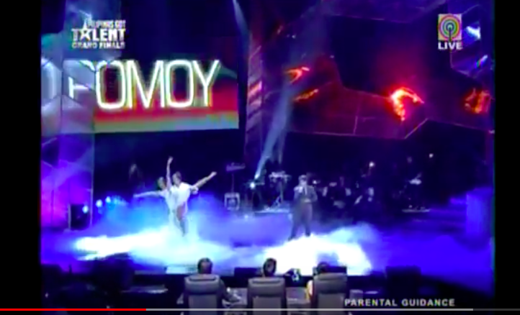
Watch and Write
Philipino Idol Winner

Slide 10
Sentence-Combining 2
Coordinating Conjunctions

Slide 11
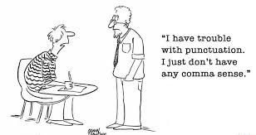
IC, BOYFANS ic.

Slide 12
Coordinating Conjunctions
But
Or
Yet
For
And
Nor
So

